Slide 1
Unit 4 : Sequential circuits
Difference between combinational and Sequential circuits, RS Flip-Flop using NAND gate, D Flip Flop, J K Flip, T Flip Flop, Types of Shift Register, Counters: Types of Counters, Concept of Excitation Table,
Designing of 3-bit synchronous counter. Designing of Random sequence generator.

Slide 2
Introduction
The combinational logic circuit and sequential logic circuits differ mainly in the way the outputs are obtained.
In combinational circuits, the outputs are the function of the combination of inputs applied at given time. But there are certain situations like wherein the output of the logic circuits should be generated after the occurrence of particular sequence of inputs.
For example in traffic light controller circuit, the Green light should be turned ON only after RED light, or Washing machine should start wash cycle only after having sufficient water in the tub, and so on. Such circuits are popularly known as sequential circuits.
In sequential circuits, the output of the circuit is a function of present input as well as past inputs. This indicates there is a need to some kind of memory cell to store the previous inputs.

Slide 3
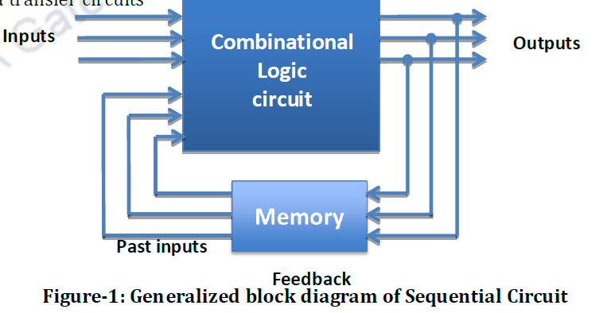
Sequential circuits are essentially consisting of combinational circuits with feedback. Figure 1 represents a generalized block diagram of sequential circuits.

Slide 4
The combinational logic circuit (containing AND, OR etc.) has two sets of inputs i.e. the external (present) inputs and the (past) inputs fed back from output through memory.
The memory stores an output from the combinational circuit that is fed back to the combinational logic input to constitute the past inputs (present state) of the circuit.
The output from the combinational logic that forms the inputs to the sequential circuit elements constitutes the next state of the circuit.

Slide 5
Parameter | Combinational Circuit | Sequential Circuit
1. Principle | At any time, outputs are dependent on combination of present inputs | At any time, outputs are dependent not only on present inputs but also on past inputs
2. Memory | Not present | Required to store past inputs/output
3. Speed | Faster | Slower
4. Clock | Clock signal is not required. | Clock signal is required.
5. Design | Easier | Comparatively difficult to design
6. Ex | MUX,DEMUX ENCODER DECODER ETC | FLIP FLLOP, COUNTER,SHIFT REGISTER1

Slide 6
Types of sequential circuits
There are two types of sequential circuits: Synchronous and Asynchronous.
1. The outputs of Synchronous circuit changes only at specific time. This circuit achieves synchronization by using a timing signal called the clock.
2. In Asynchronous sequential circuits, the output changes at any time. No need of clock signal.

Slide 7
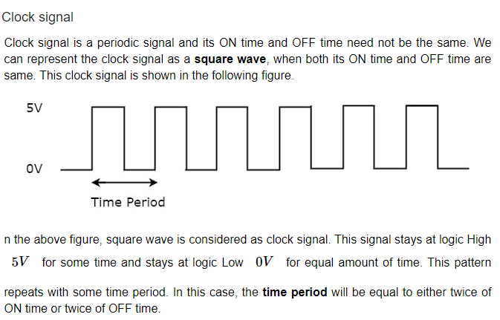
Clock Signal and Triggering

Slide 8
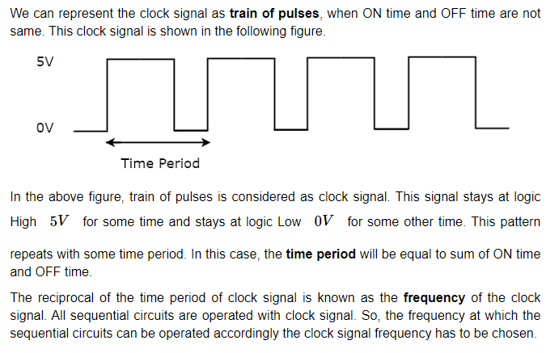

Slide 9
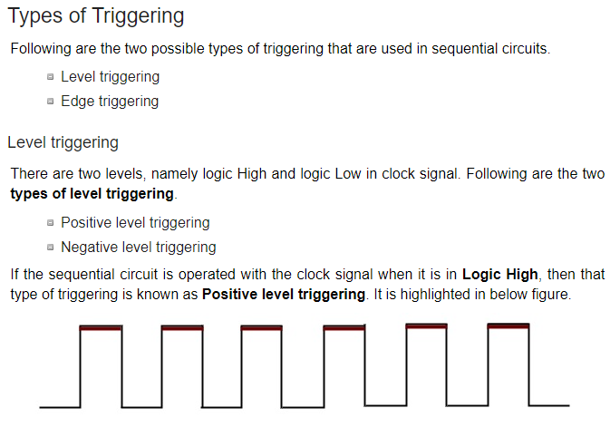
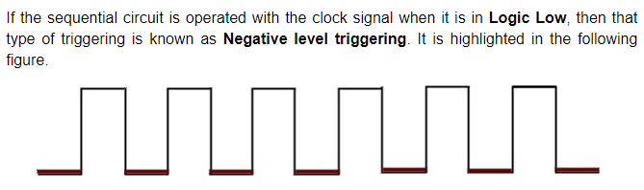

Slide 10
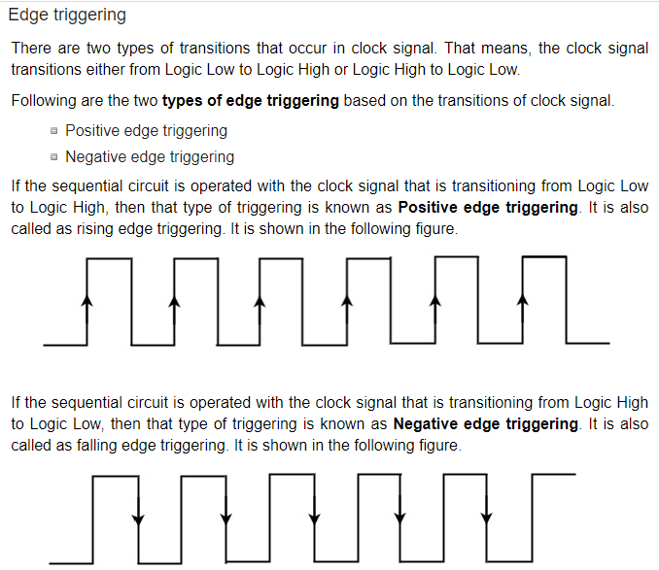

Slide 11
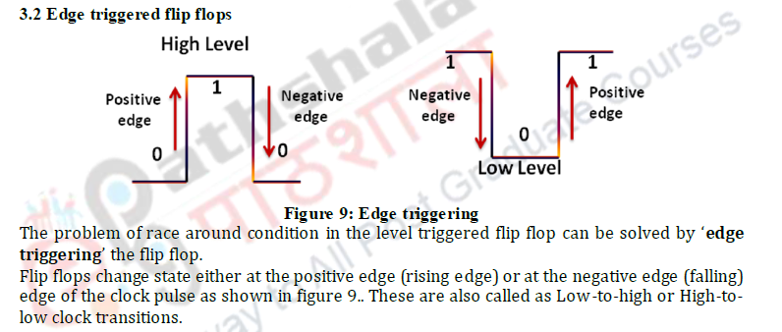

Slide 12
Flip flops
Flip – flops have two stable states and hence they are bistable multivibrators. The two stable states are High (logic 1) and Low (logic 0).
The term flip – flop is used as they can switch between the states under the influence of a control signal (clock or enable) i.e. they can ‘flip’ to one state and ‘flop’ back to other state.
Flip – flops are a binary storage device because they can store binary data (0 or 1).
Flip – flops are edge sensitive or edge triggered devices i.e. they are sensitive to the transition rather than the duration or width of the clock signal.
They are also known as signal change sensitive devices which mean that the change in the level of clock signal will bring change in output of the flip flop.
A Flip – flop works depending on clock pulses.
Flip flops are also used to control the digital circuit’s functionality. They can change the operation of a digital circuit depending on the state.
Some of the most common flip – flops are SR Flip – flop (Set – Reset), D Flip – flop (Data or Delay), JK Flip – flop and T Flip – flop

Slide 13


Slide 14
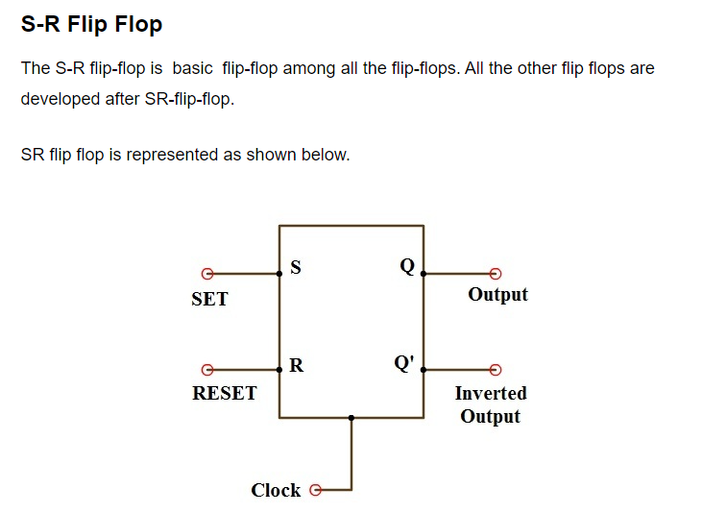

Slide 15
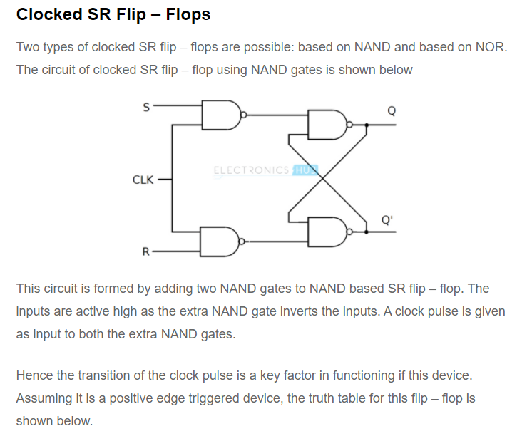

Slide 16
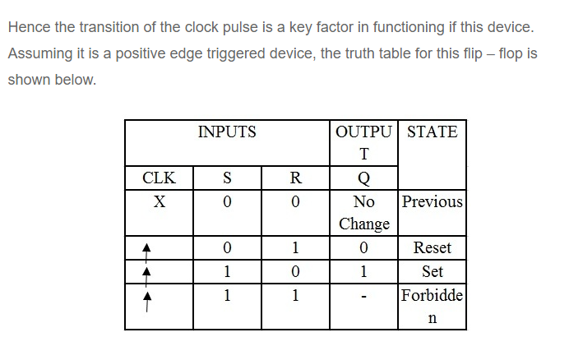

Slide 17
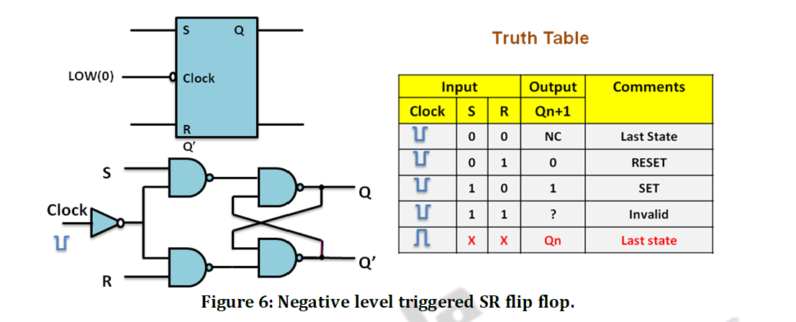

Slide 18
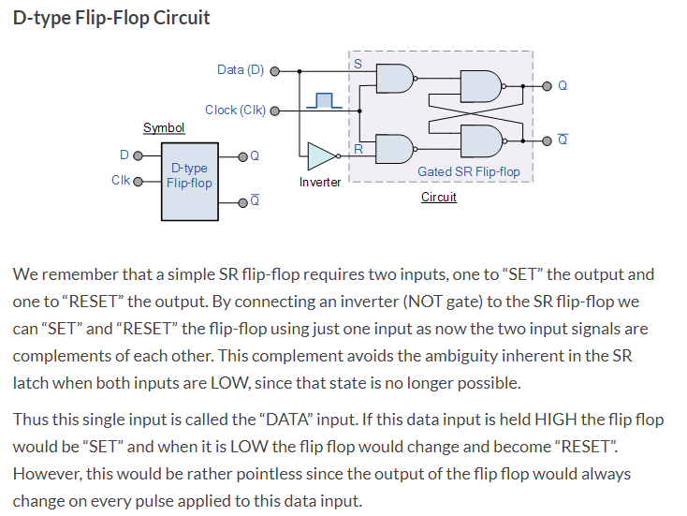

Slide 19
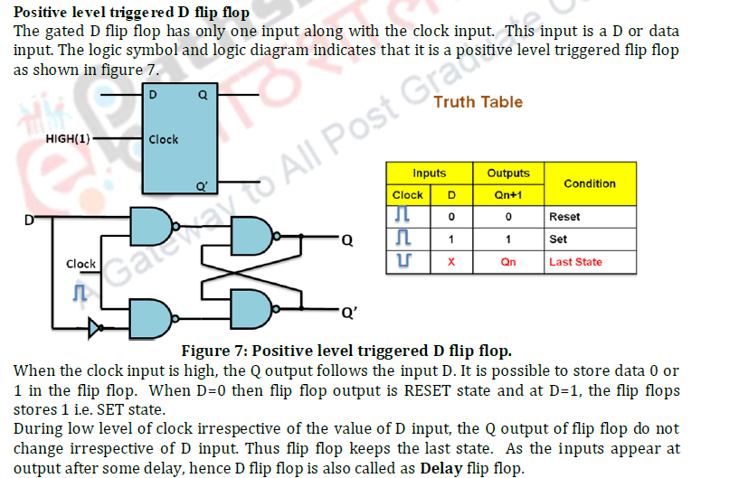

Slide 20
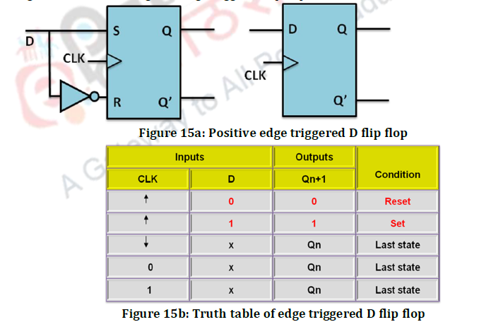

Slide 21
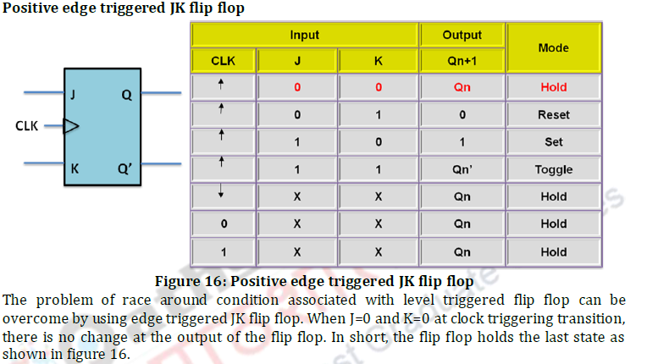

Slide 22
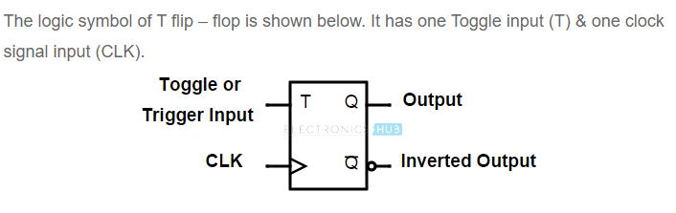
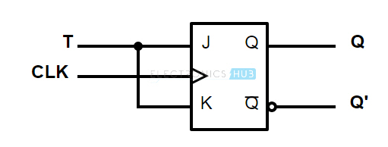
T Flip flop

Slide 23
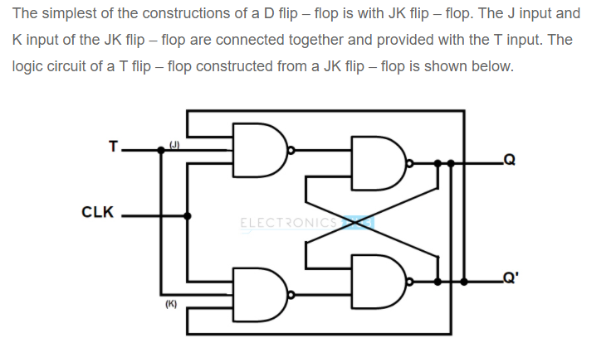
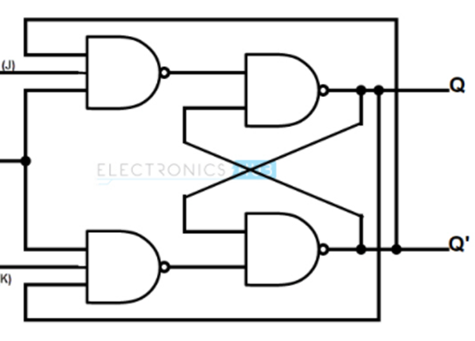

Slide 24
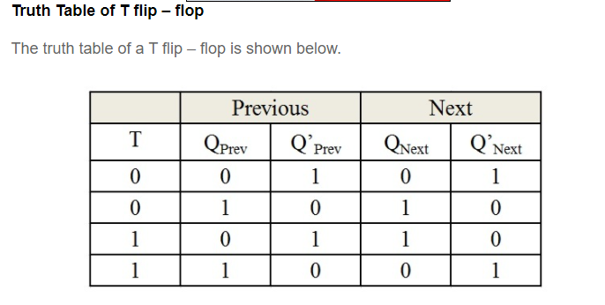

Slide 25
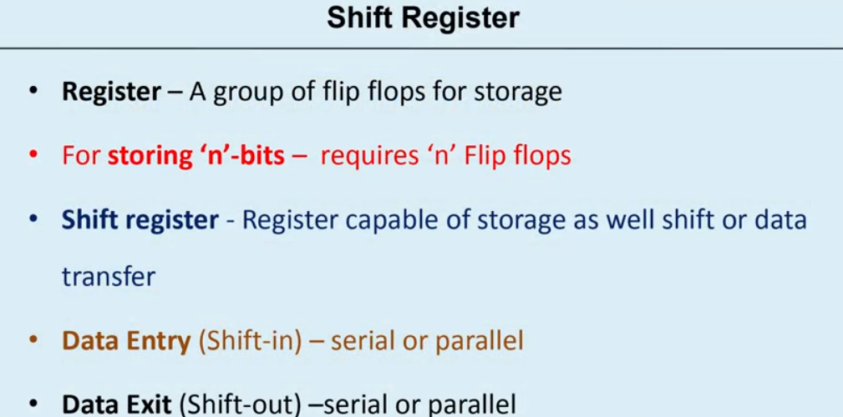
8421
0010 2
0100 4
1000 8
SHIFT LHS =====MULTIPLY BY 2
SHIFT RHS=========DIVISION 2

Slide 26
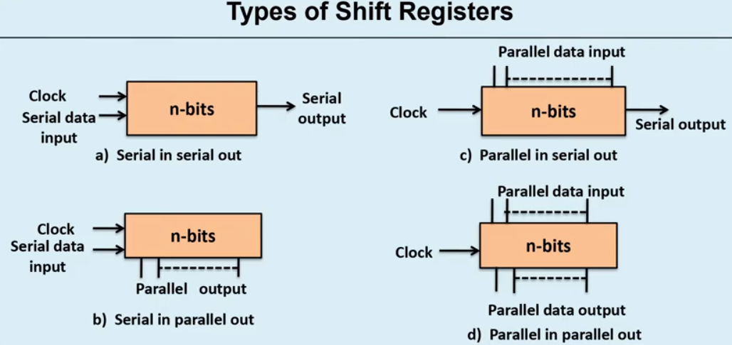
Type | FOR 4 BIT (IN) | OUTPUT | total number of clock cycles REQUIRED
SISO | 4 CLK | 4 CLK | 8
SIPO | 4 CLK | 1 CLK | 5
PISO | 1 CLK | 4 CLK | 5
PIPO | 1 CLK | 1CLK | 2

Slide 27
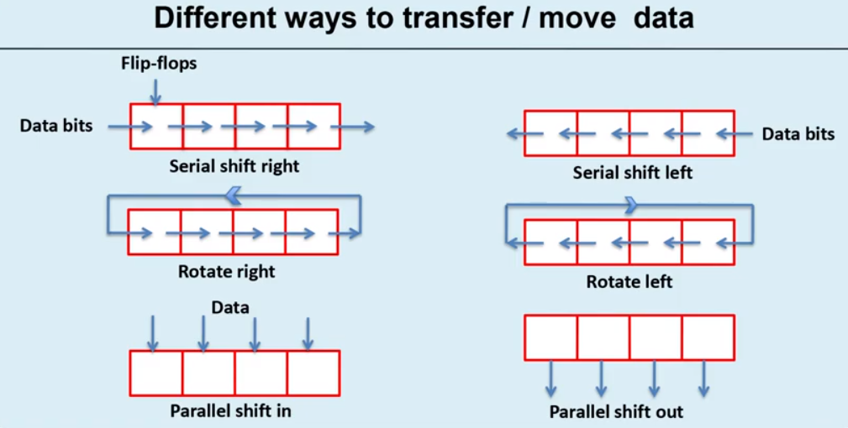
8421

Slide 28
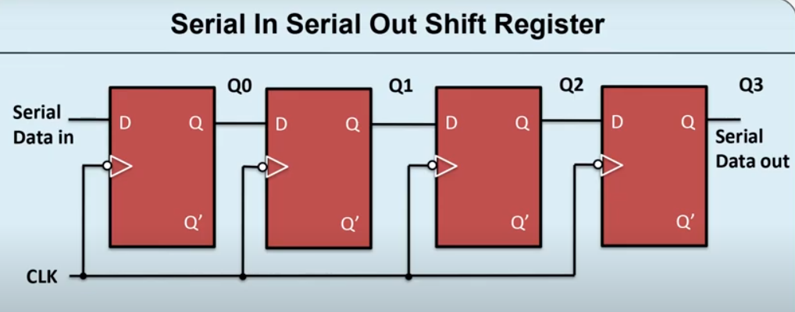
1010
1ST CLK | 0
2ND | 1 | 0
3 | 0 | 1 | 0
4 | 1 | 0 | 1 | 0
5 | 0 | 1 | 0 | 1
6 | 0 | 0 | 1 | 0

Slide 29
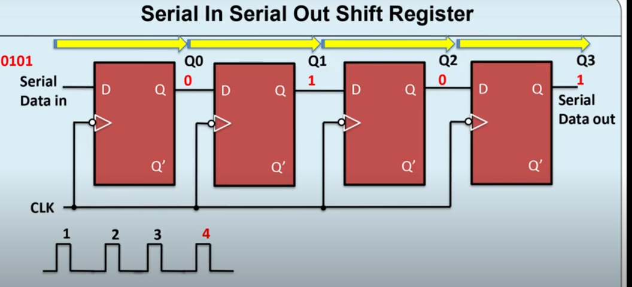

Slide 30
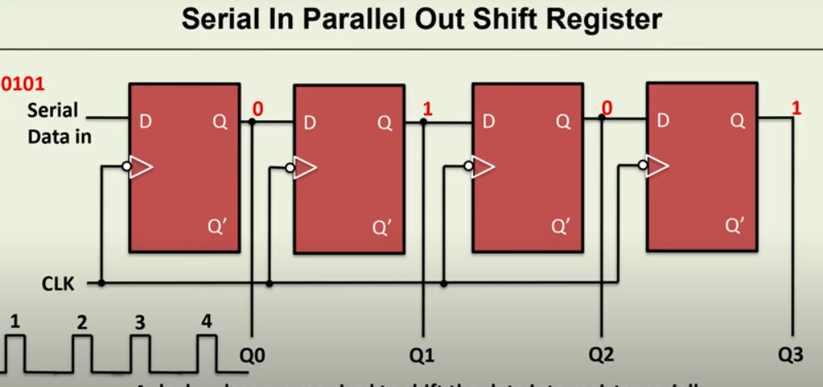

Slide 31
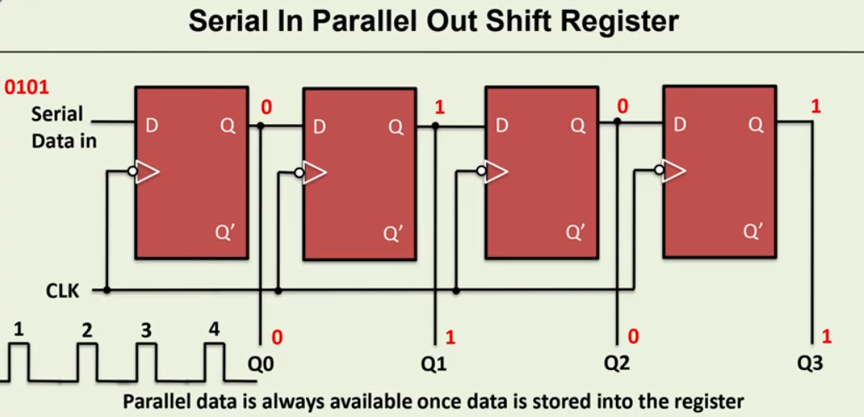

Slide 32
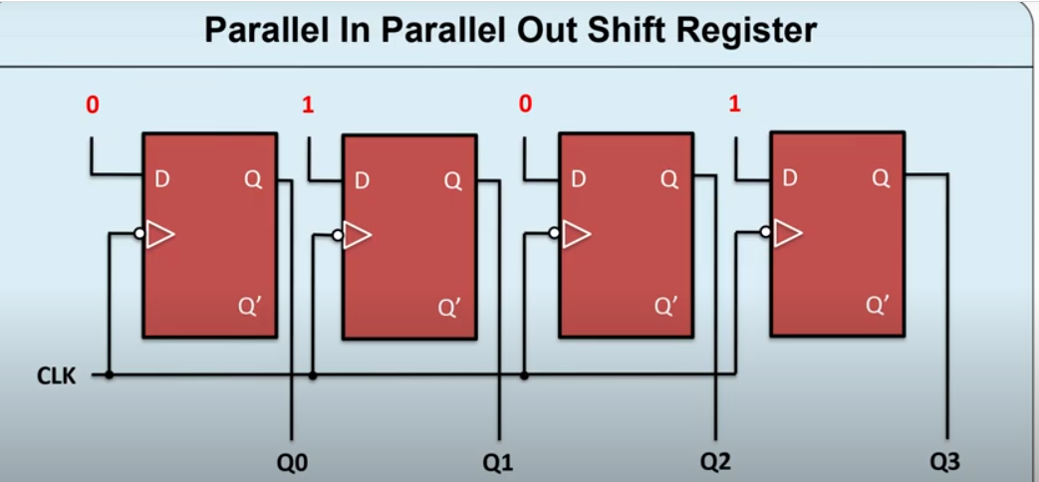

Slide 33
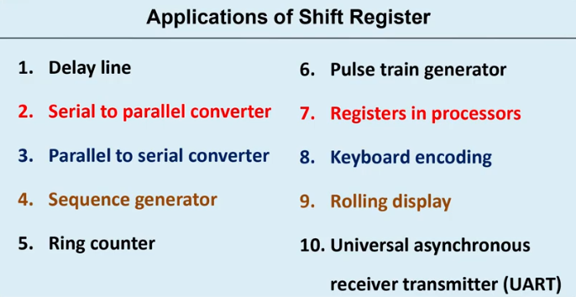

Slide 34
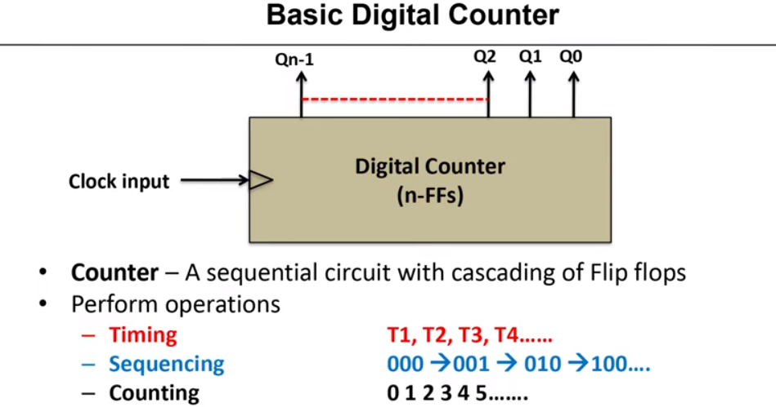

Slide 35
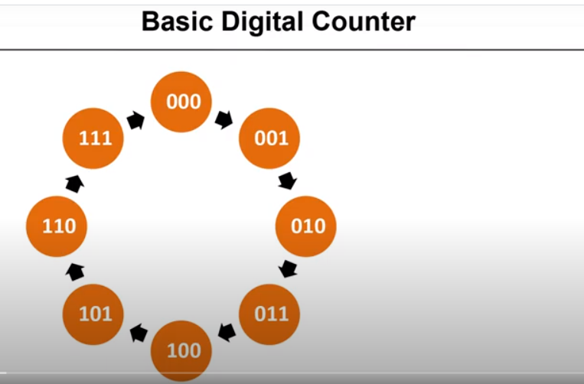

Slide 36
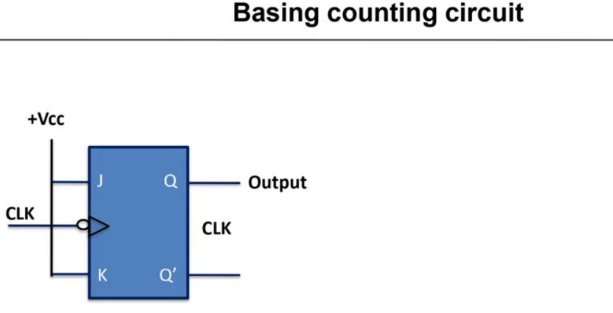

Slide 37
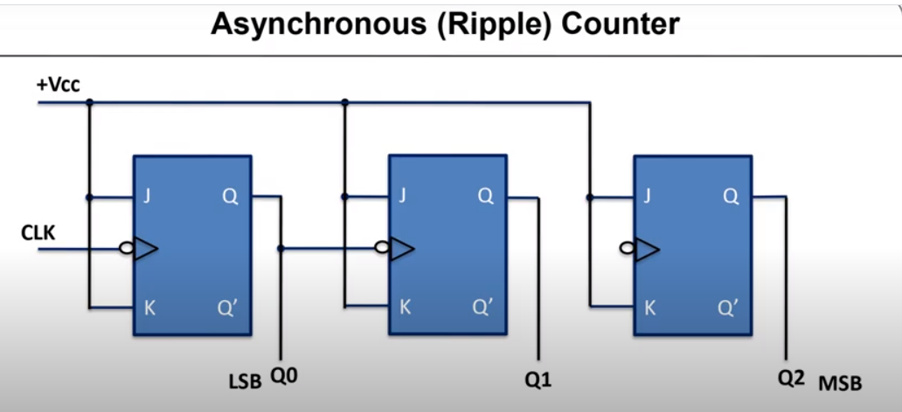
CLK | Q2 | Q1 | Q0 | DECIMAL
NO CLK(RESET) | 0 | 0 | 0 | 0
1 | 0 | 0 | 1 | 1
2 | 0 | 1 | 0 | 2
3 | 0 | 1 | 1 | 3
 |  |  |  | 4
 |  |  |  | 5

Slide 38
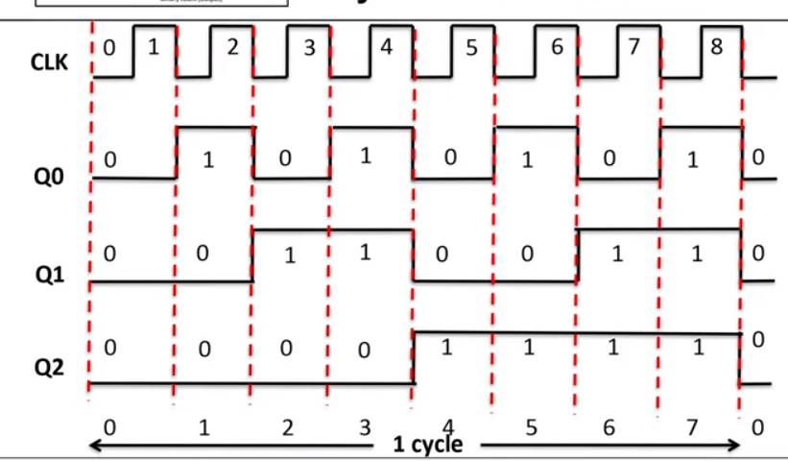

Slide 39
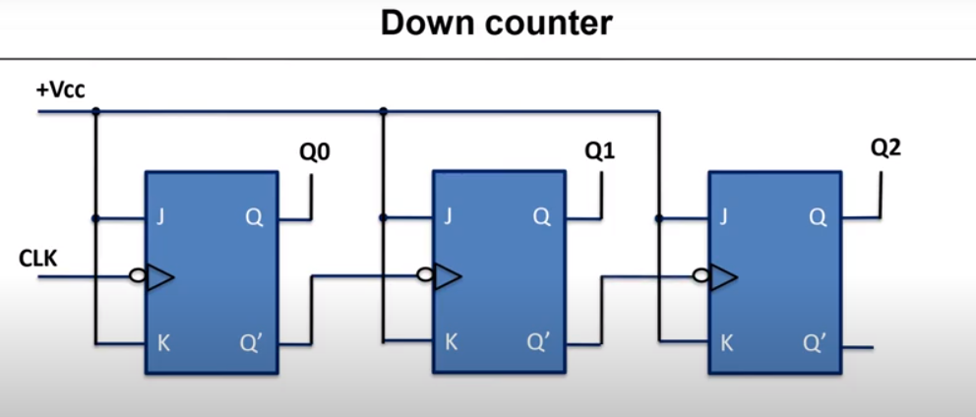

Slide 40
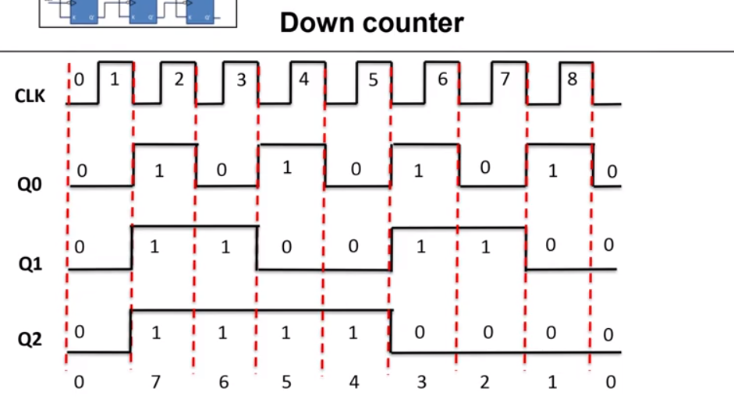

Slide 41
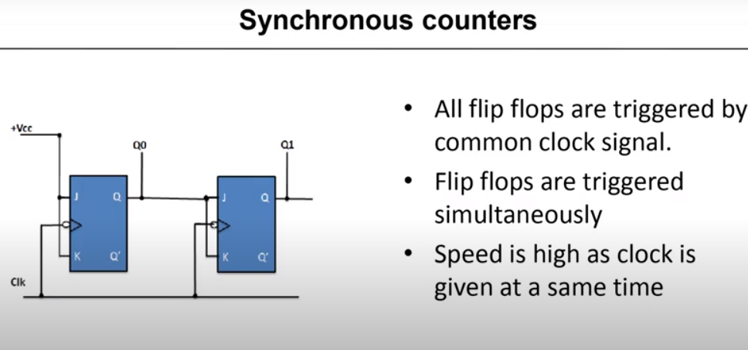
clk | Q1 | Q0 | DECIMAL
NO (RESET) | 0 | 0 | 0
1ST FALLING | 0 | 1 | 1
 | 1 | 0 | 2
 | 1 | 1 | 3
 | 0 | 0 | 0

Slide 42
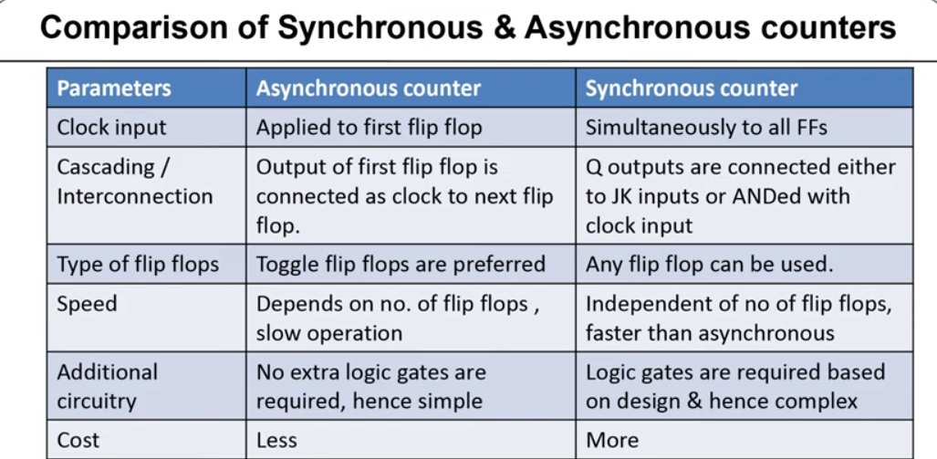

Slide 43
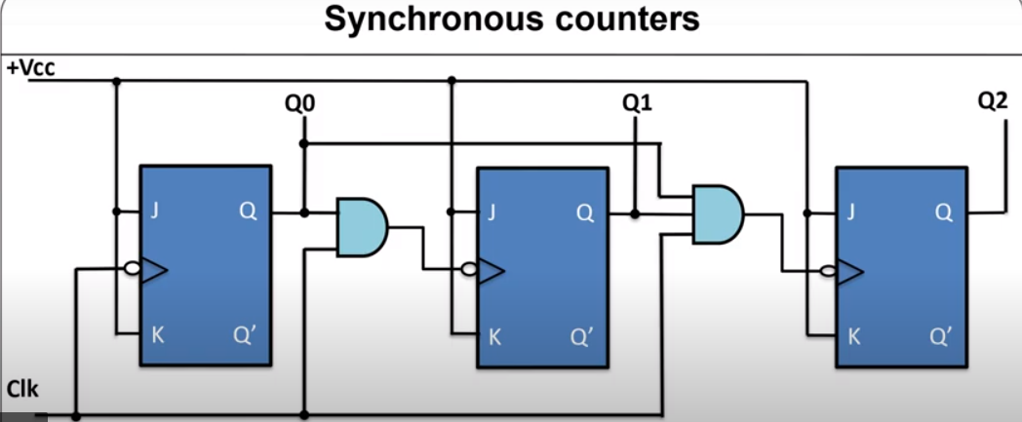

Slide 44
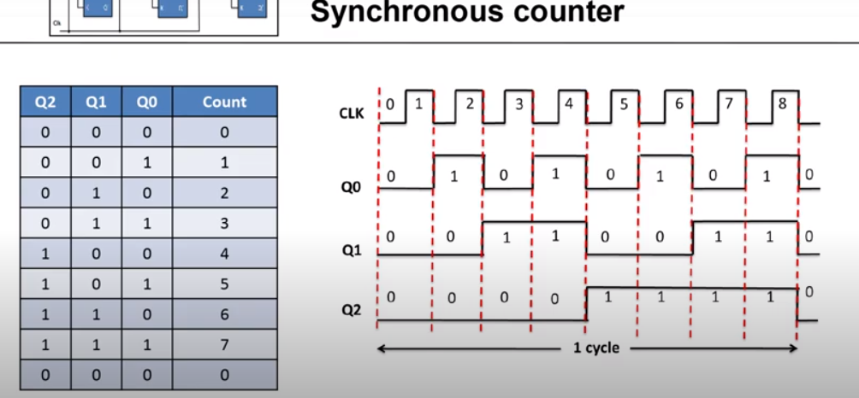

Slide 45
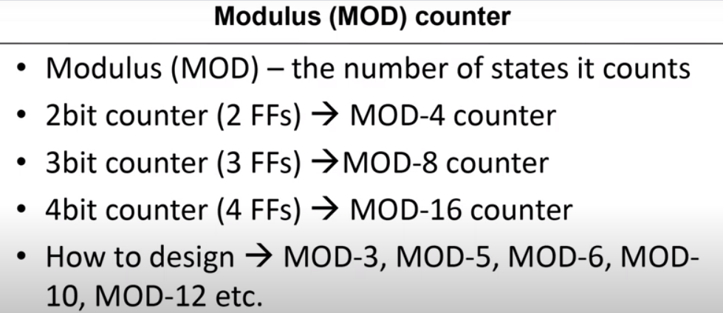

Slide 46
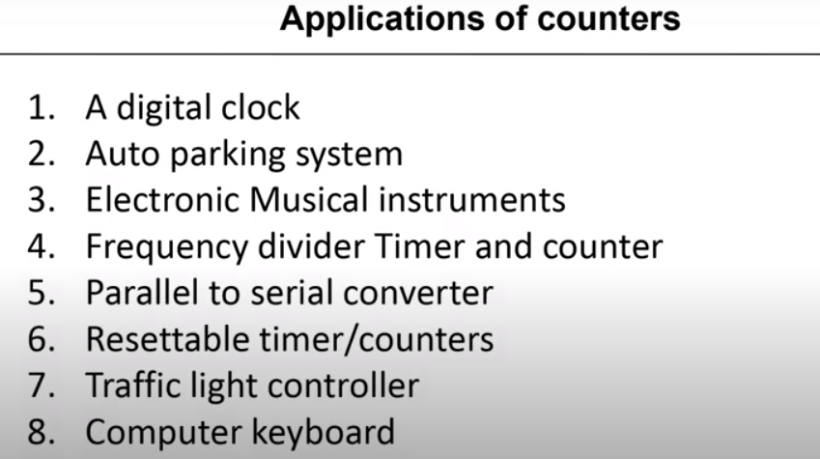

Slide 47
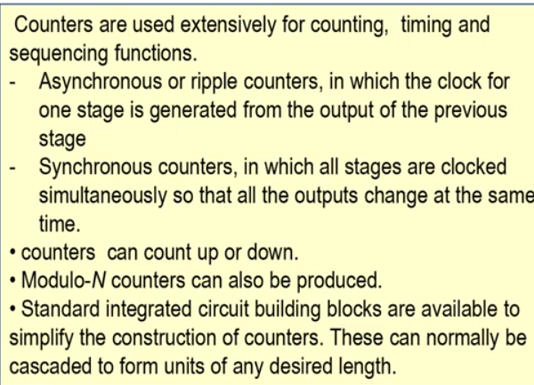

Slide 48
A 4-bit synchronous counter uses flip-flops with propagation delay times of 15 ns each. The maximum possible time required for change of state will be…….?
Ans : 15 ns
A 4-bit Asynchronous counter uses flip-flops with propagation delay times of 15 ns each. The maximum possible time required for change of state will be…….?
Ans : 60 ns
Decade counter: 0 to 9 :=10 states= MOD 10

